Slide 1
Brother 2 Brother: The Blueprint for Establishing a Mentoring Program for Boys of Color
Brian Tate
School Improvement Leader
B2B Administrator, Hiatt Middle School

Slide 2
“Rationale and Mission”

Slide 3
Rationale and Mission
Many of our male students exhibit behaviors that keep them from excelling in their academics, establishing positive relationships with others, and from being exposed to positive experiences that would in fact shape their thinking about their own lives
The mission of B2B is to provide African American male students a positive experience and interaction everyday to help them grow and develop not only a positive self image of what they can become, but also build up the confidence and stamina to compete in the global society

Slide 4
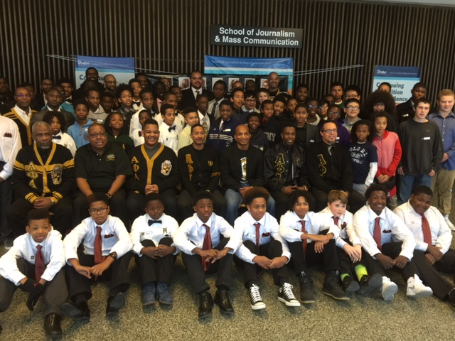
Vision & Mission Statements
Vision Statement: The Amos Hiatt B2B program will be the model for mentoring programs involving males of color in the Des Moines Public Schools
Mission Statement: We will inspire minds by creating an academic community that challenges students to engage in their futures

Slide 5
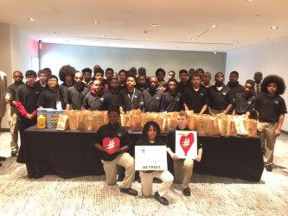
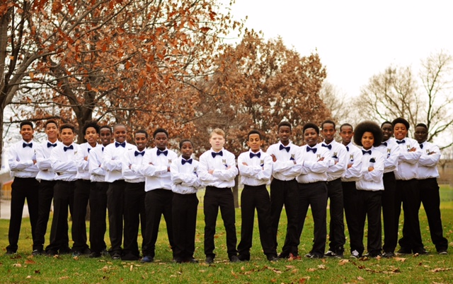
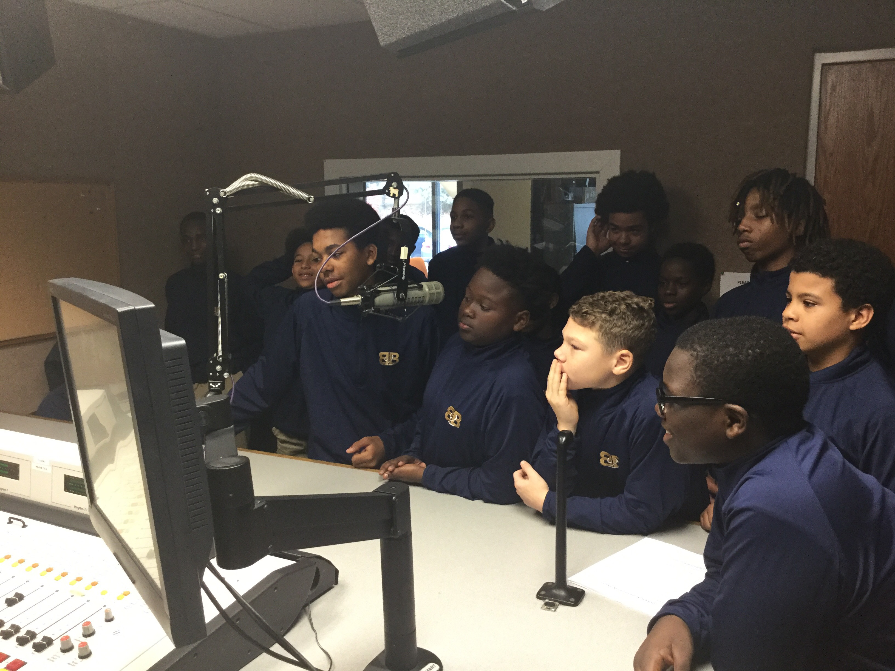
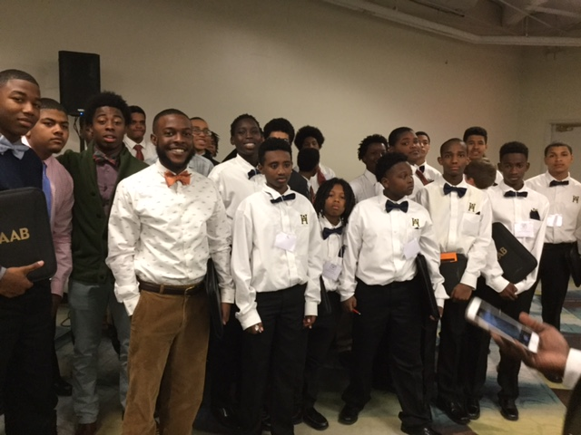
Hiatt B2B Mentoring Program

Slide 6
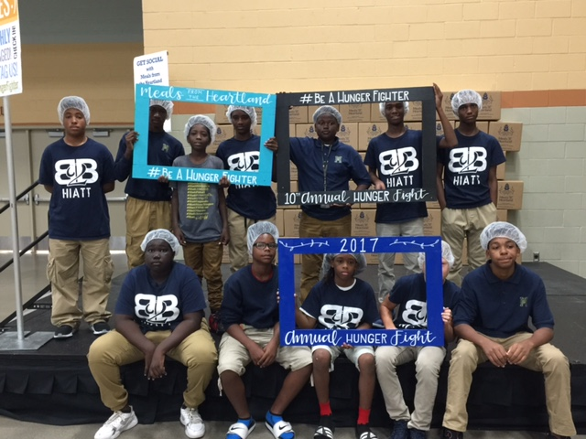
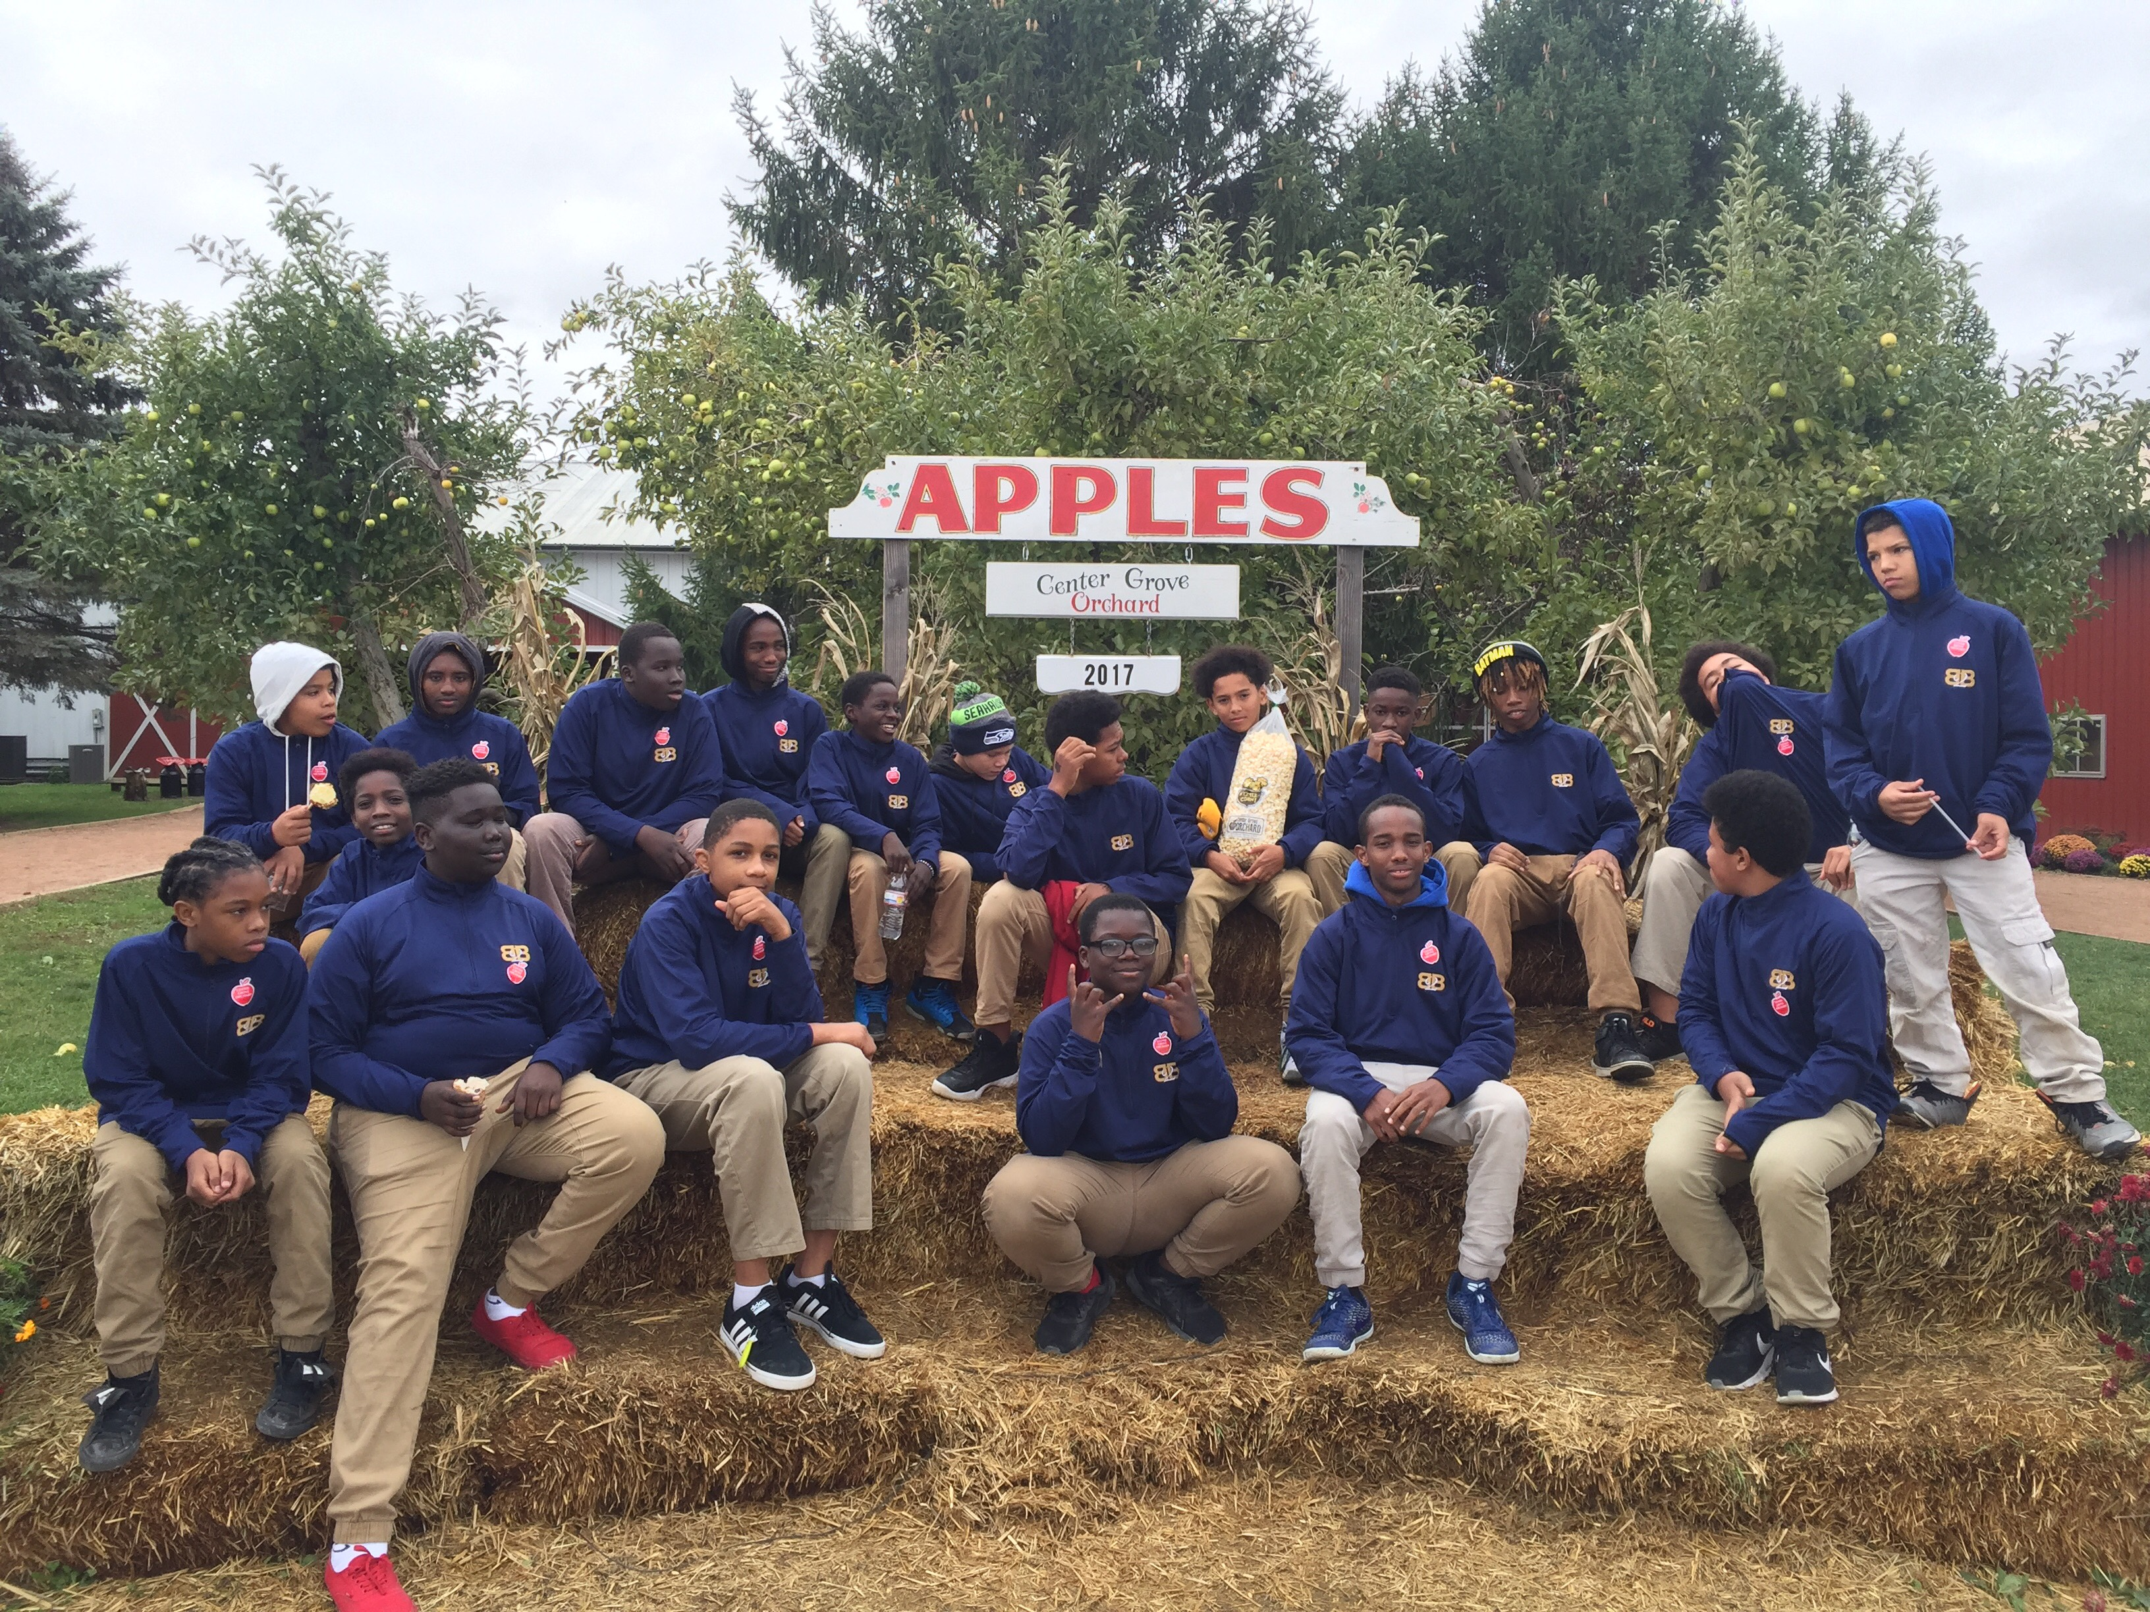
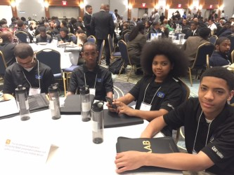
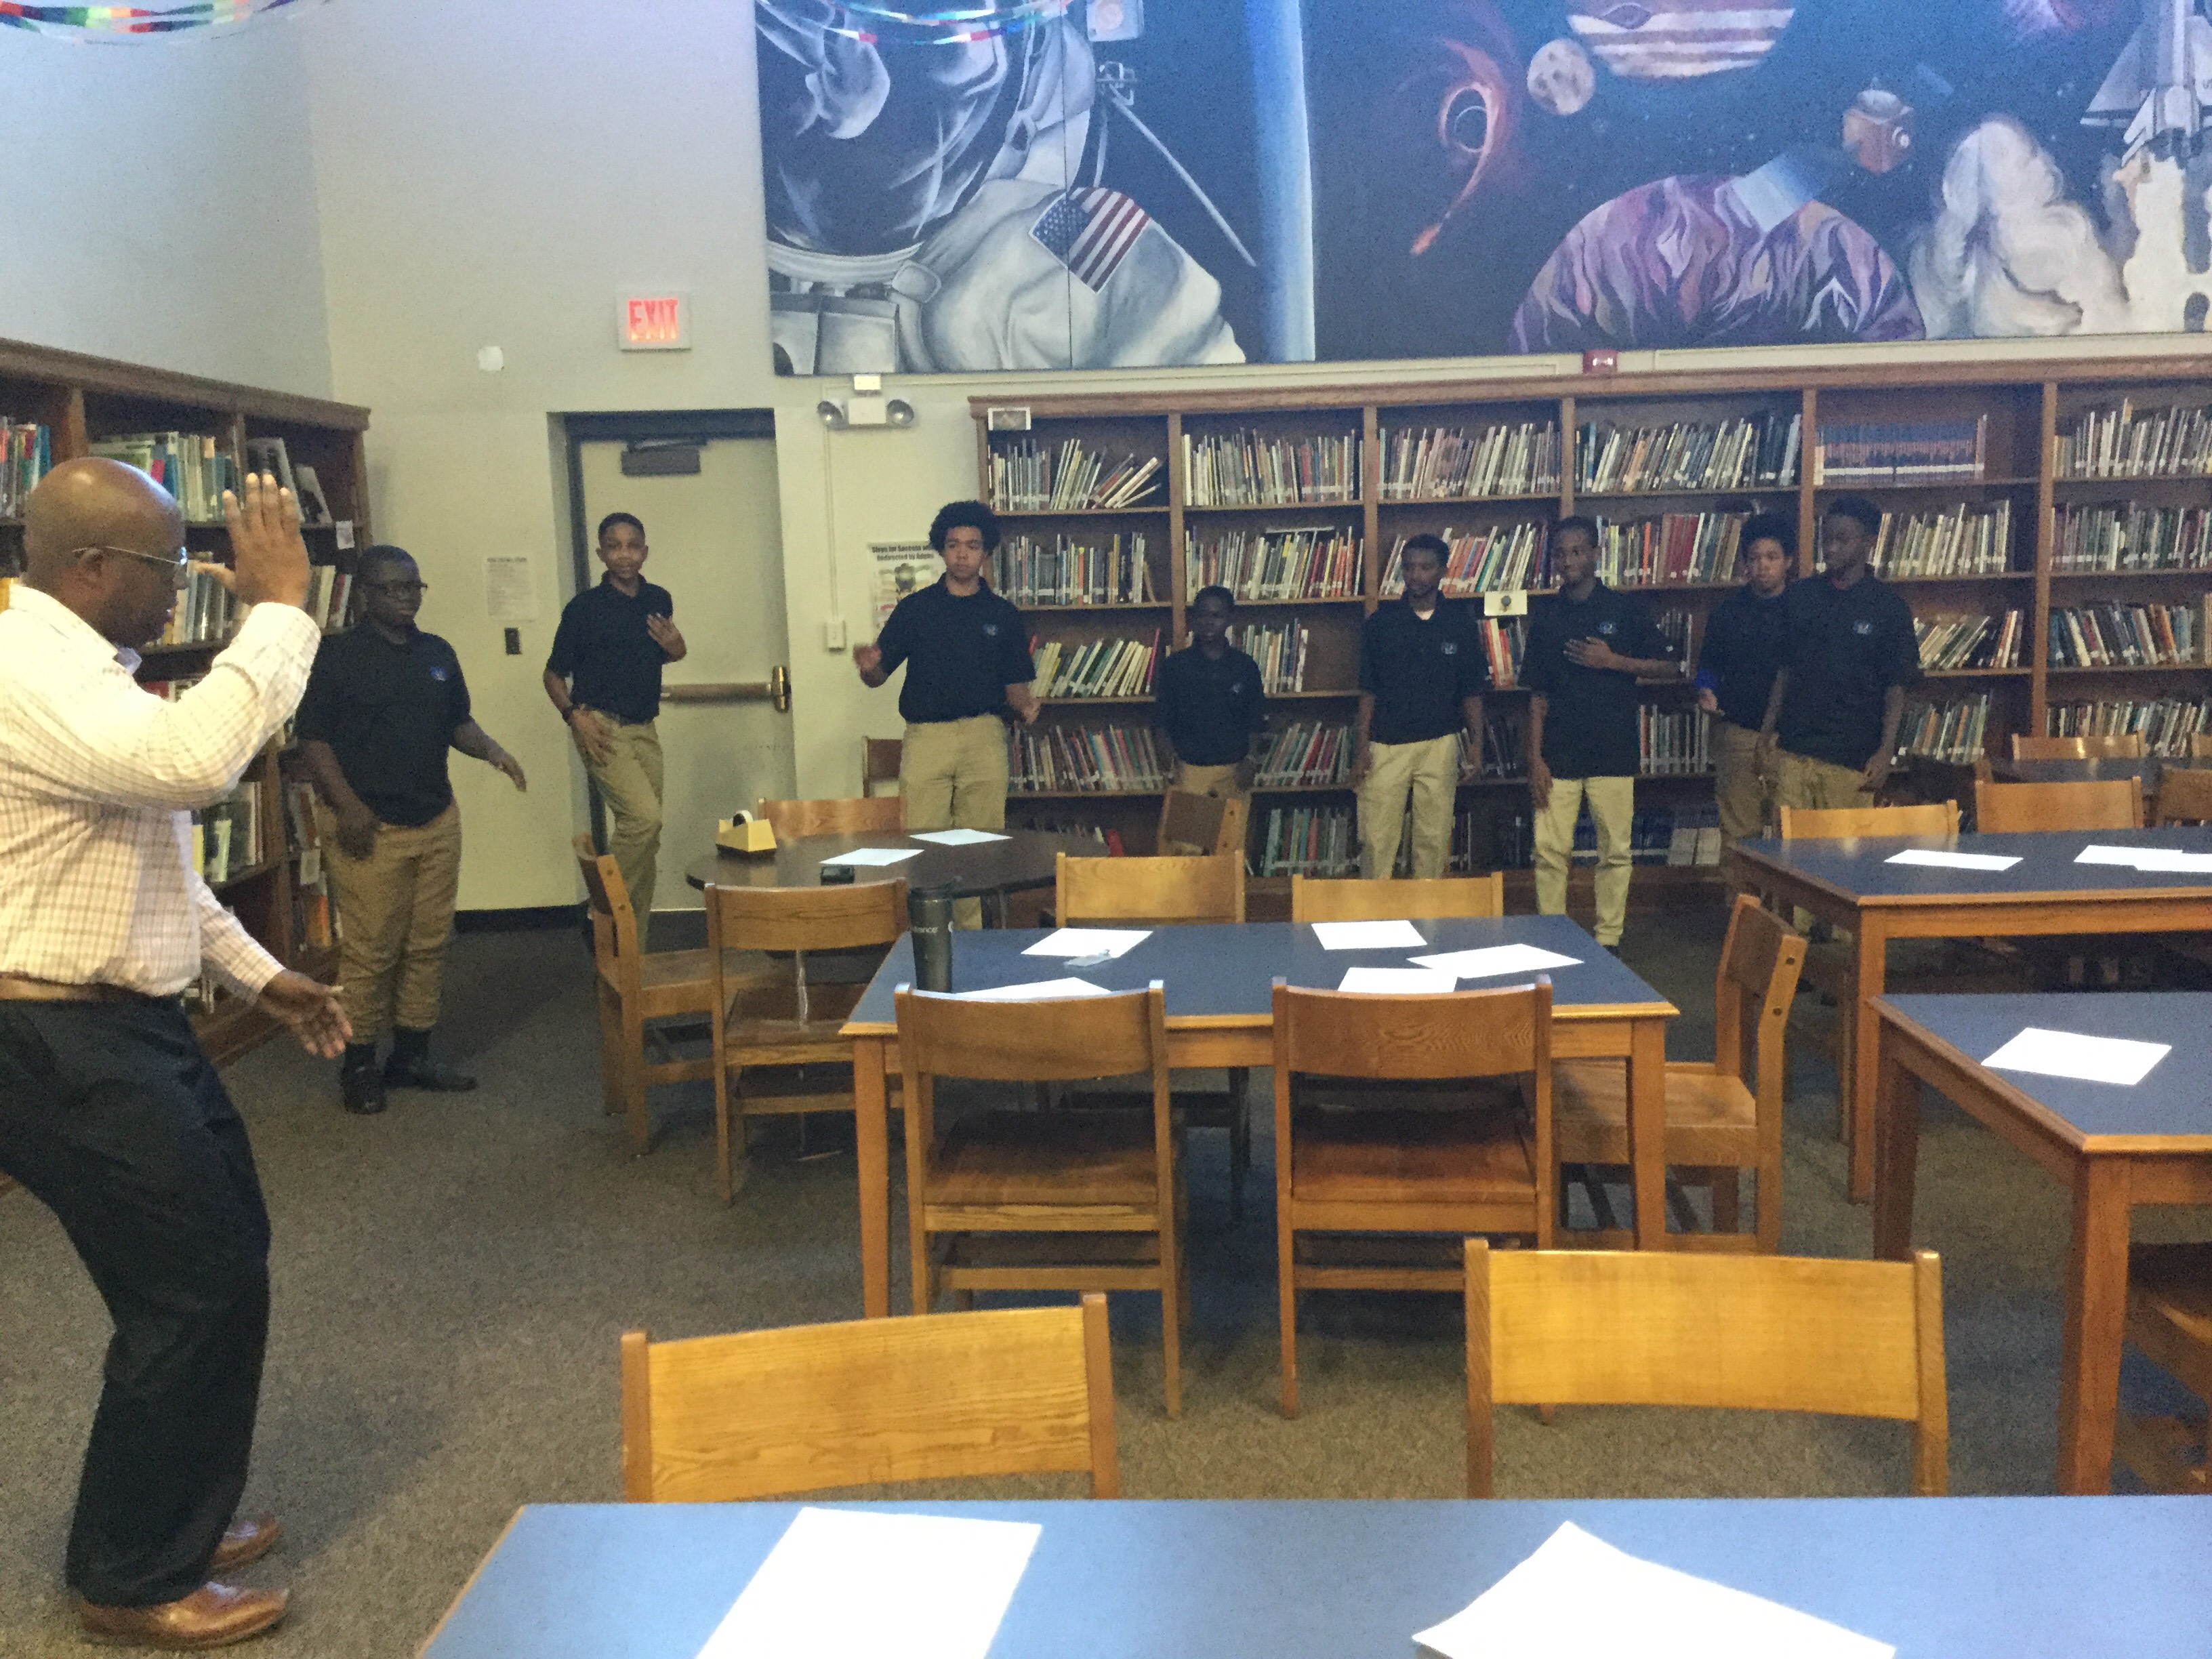
Hiatt B2B Mentoring Program

Slide 7
Program Goals
Goal #1: To enhance the persistence of our members with a goal of lowering drop-out rates and suspension of all students
Objective #1: Assist the school administration in its efforts to address drop-out rates, absenteeism, and suspensions
Objective #2: Develop and implement programs that help maintain connections and cultivate a sense of inclusion for all members

Slide 8
Program Goals
Goal #2: To strive for academic excellence with goals of surpassing GPA expectations as well as creating and implementing a post-secondary plan, whether pursuing college or a career
Objective #1: Set specific goals for all B2B members
Objective #2: Complete grade checks once a month for the purpose of measuring academic progress

Slide 9
Program Goals
Goal #3: To enhance the image of our members as positive and active participants on campus and contributing citizens in the larger community
Objective #1: For each B2B member to project a positive self-image that is professional and confident

Slide 10
Program Goals
Goal #4: To create and encourage collaborative relationships between students, members of the school district community, and the larger Des Moines community
Objective #1: Establish and strengthen our relationships with members of our school and wider district community

Slide 11
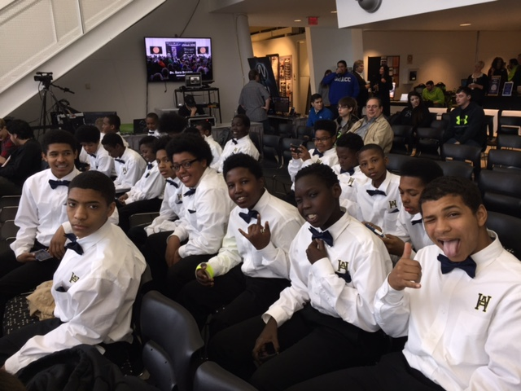
Program Description
Program Description
Academic Tutoring:
Monthly Grade Checks
Eligibility Policy/
Leadership Opportunities:
Service Learning Projects
Reading buddies
Facilitating projects during Enrichment/Advisory
Program Activities:
B2B Meetings, BMW Speakers
Field Trips, College Visits, Service Projects

Slide 12
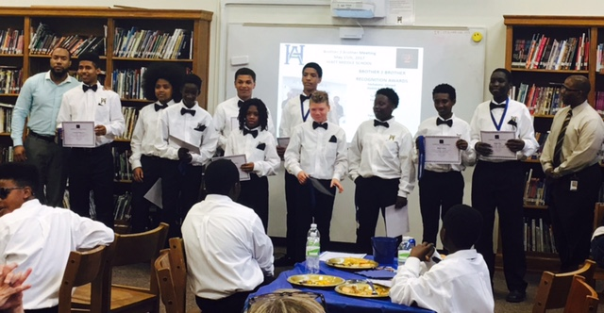
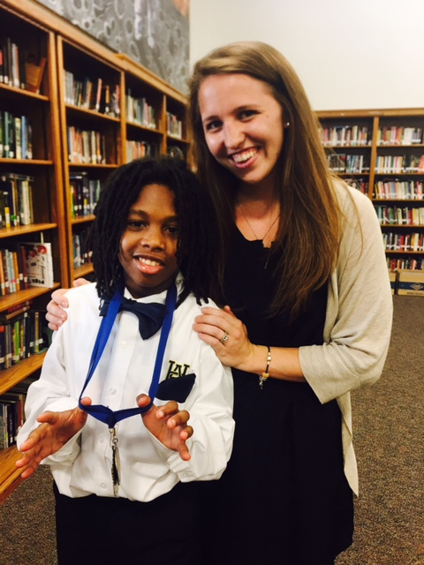
Program Evaluation
Grades
Attendance
Level II Referrals
Other Disciplines
Assessments (MAP, IA Assessments)
Extra-Curricular Activities

Slide 13
Community Support & Networks
Student African-American Brotherhood
Des Moines Public Schools
Drake University
Polk County Betterment Grant
Seneca Companies (Hiatt)
Wells Fargo (Hiatt)
Merck Corporation (Hiatt)

Slide 14
CONTACT INFORMATION
For any information questions, donation requests, & offering to be a guest speaker, please contact Brian Tate (B2B Administrator) at brian.tate@dmschools.org

Slide 15
Video Clip
https://youtu.be/ZFhS7ptPjb8

Slide 16
THANK YOU!
SAVING LIVES….
SALVAGING DREAMS!!!
I am my brother’s keeper…
And together we will Rise!

